Slide 1
#02 Inheritance and Polymorphism
Notes:
Give an explanation for the concepts inheritance and polymorphism
Relevant theoretical decisions
What is inheritance, when and how is it used?
How are the relationship between references and objects in an inheritance hierarchy?
What are static and dynamic types?
What is polymorphism, when and how is it used?
How do you understand the concepts early and late binding?
What is a polymorphic method?

Slide 2
Inheritance
Generalization and Specialization
writing code that is reusable
new class, ListBox, which derives from Control
C# does not allow multiple inheritance, but does allow implementing multiple interfaces
Notes:
C# has two separate mechanisms for writing code that is reusable across different types: inheritance and generics.
Inheritance is used for Generalization and Specialization of code.
Saying that ListBox inherits from (or derives from) Control indicates that it specializes Control. Control is referred to as the base class, and ListBox is referred to as the derived class.
This code declares a new class, ListBox, which derives from Control. You can read the colon as “derives from.”

Slide 3
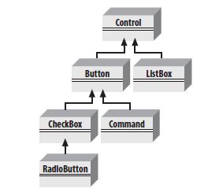
Hierarchy and Single Inheritance

Slide 4
Static and Dynamic

Slide 5
Polymorphism

Slide 6
Binding

Slide 7
Polymorphic method

Slide 8
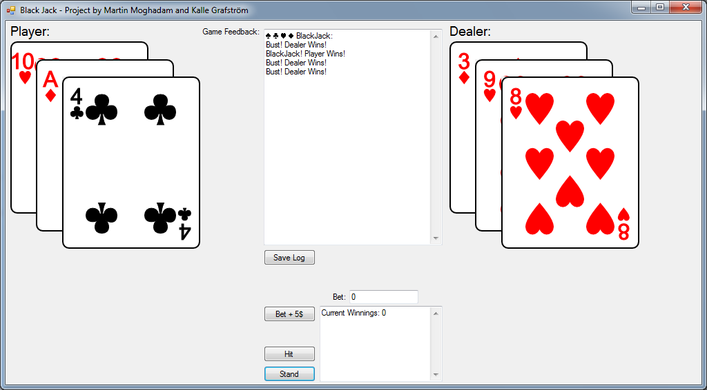
Our program
Black Jack Game
Log
Save Log
Beting
Hit
Stand

Slide 9
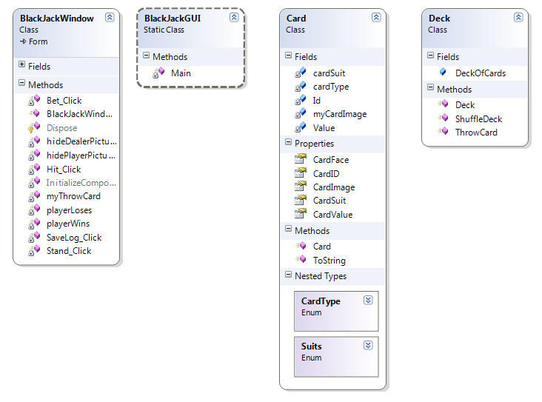
Our program
Notes:
Our application contains a simple card class, and a deck class.
A deck of cards is a list that contains objects of the type card.

Slide 10
Questions?

